Slide 1
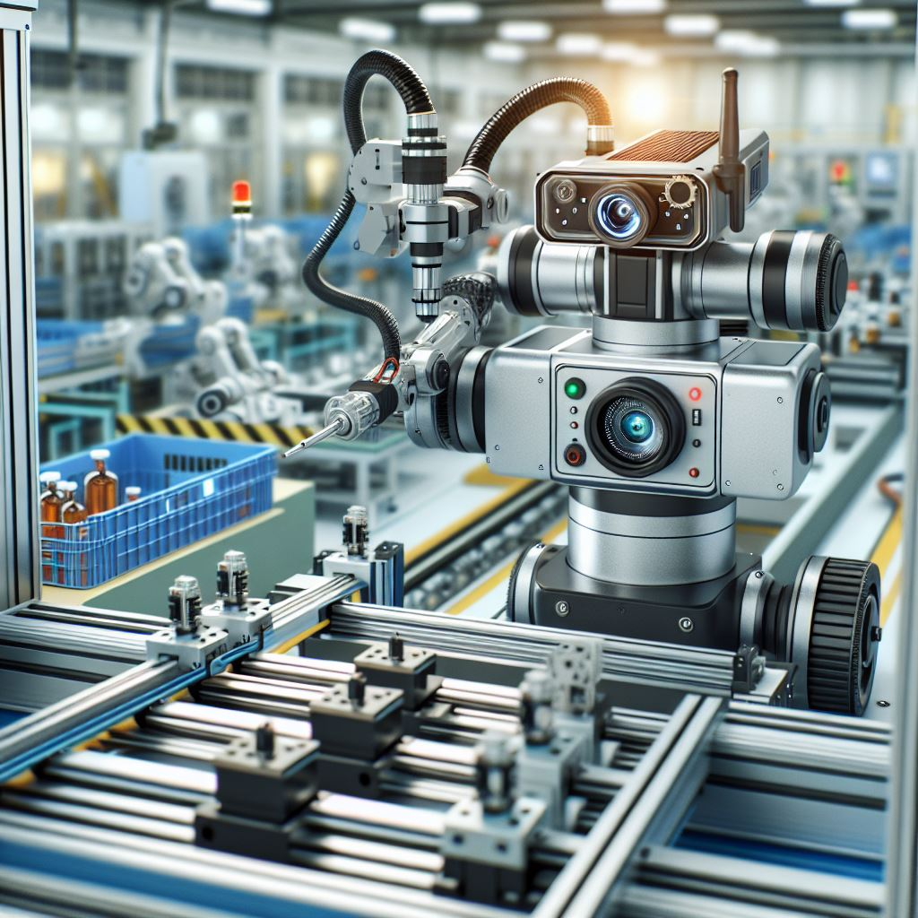
Introduction to Machine Vision
Understanding the Technology Behind Visual Perception in Machines
Instructor: Stephin Rachel Thomas
15-01-2026

Slide 2
General Information
Course Brightspace page https://brightspace.algonquincollege.com/d2l/le/content/846092/Home
Please read the course outline and course section information (CSI)
Main focus of the labs is to assess your understanding of implementation and demo your work in each session
Professional behaviour is expected from all the students
Lab activities and assignements should be done individually, and any use of online materials, including use of ChatGPT and LLMs stated clearly as references.

Slide 3

Course Overview
This course will take you on an exciting journey through the world of Machine Vision, combining theoretical knowledge with practical applications. Get ready to explore the path from pixels to perception!
We are here right now. The field of CV is huge, we will hope to scratch the surface in this class.

Slide 4

What is Machine Vision?
Machine vision is a technology that enables machines to interpret and understand visual information from the surrounding environment.
It involves capturing images or videos using cameras or sensors, processing these images to extract useful information, and then using this information to make decisions or perform specific tasks.

Slide 5
History and Evolution of Machine Vision
The journey of Machine Vision began with simple image capturing devices, evolving through the digital revolution to sophisticated AI algorithms. Key milestones include the development of digital cameras, the rise of neural networks, and significant increases in computing power.
What was the significant turning point?
The rise of deep learning techniques

Slide 6
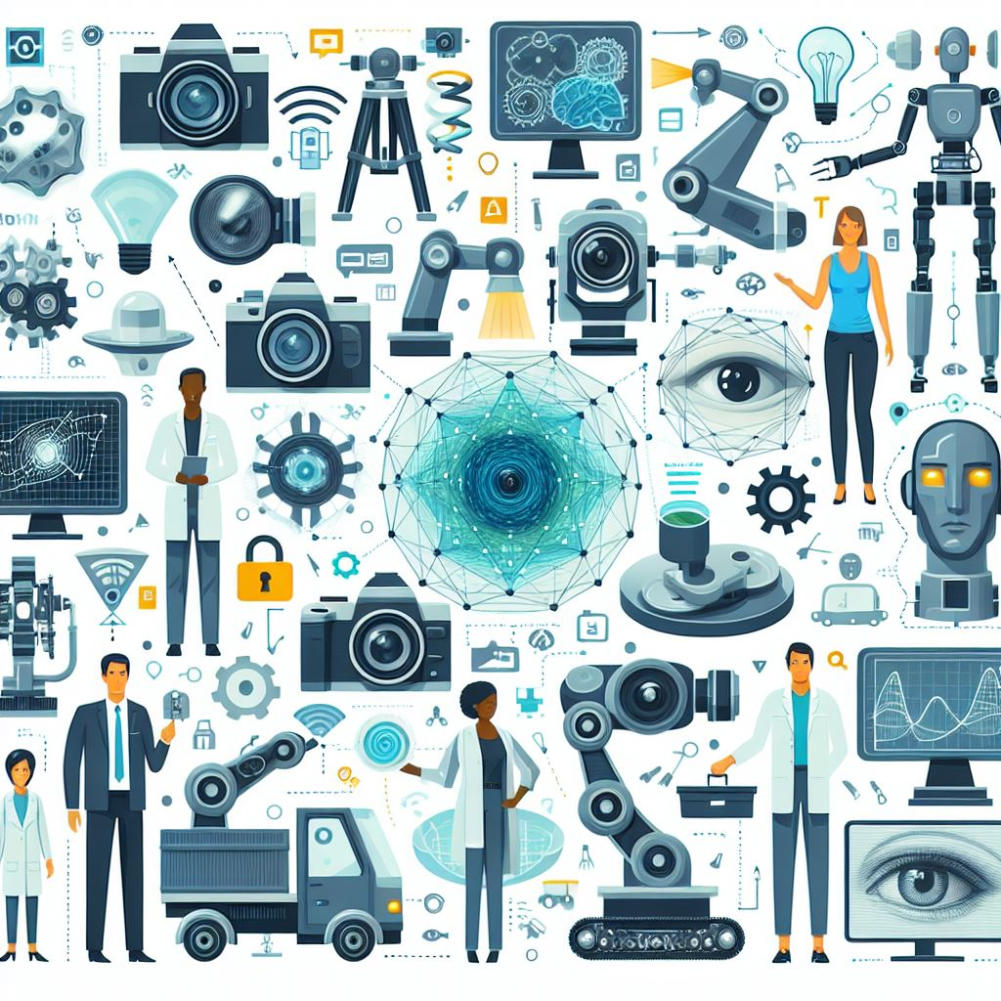
Key Technologies in Machine Vision
Essential technologies in Machine Vision include image sensors (like CCD and CMOS), image processing techniques (such as filtering and edge detection), and the role of Machine Learning, particularly deep learning, in modern Machine Vision systems.

Slide 7
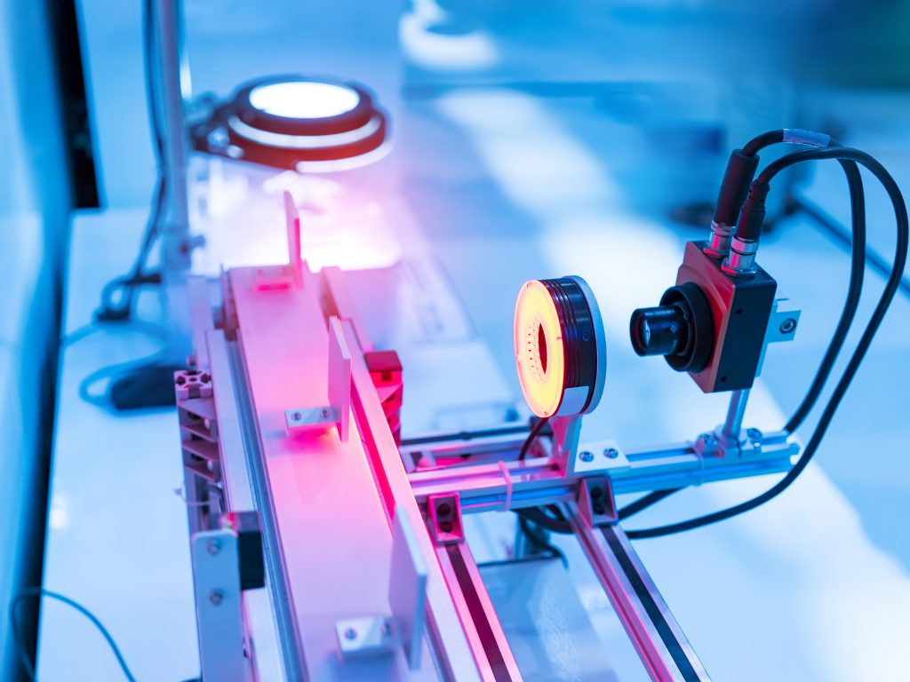
Applications of Machine Vision in Everyday Life
Machine Vision is all around us!
In retail, it's used for barcode scanning and inventory management.
In the manufacturing industry, it ensures quality checks on the assembly line.
In entertainment it allows the detection and tracking of objects of interest, enhancing visual effects in movies and games.
Lane keeping, blind spot checking, adaptive cruise, etc. in autonomous vehicles.
Think about how these technologies affect our daily lives and the efficiency of businesses.

Slide 8
Machine Vision in Advanced Applications
Machine Vision is pivotal in advanced fields.
Autonomous vehicles use it for navigation
Medical imaging uses it for diagnostics and surgical assistance
Facial recognition systems enhance security and personalized experiences.
These applications highlight the versatility and transformative power of Machine Vision.
Refer to Week 1 Asynchronous material

Slide 9
Basic Workflow of a Machine Vision System
The workflow of a Machine Vision system can be summarized in three steps:
Image Acquisition (Capturing the image)
Image Processing (Analyzing and Manipulating the image)
Interpretation/Action (Making decisions based on the processed image).
For example, in an automated inspection system in manufacturing, this workflow ensures quality control.

Slide 10
Introduction to Image Processing
Image processing forms the core of Machine Vision.
We deal with different Image Formats like JPEG, PNG, and RAW, and Color Spaces such as RGB and HSV.
Let’s see a quick example of how to read an image using OpenCV.

Slide 11
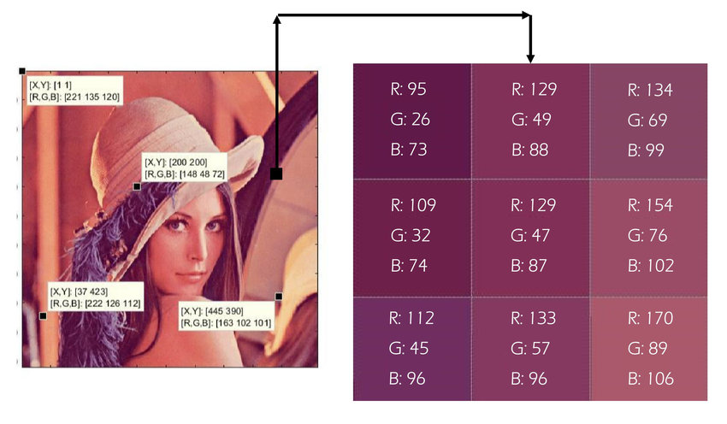
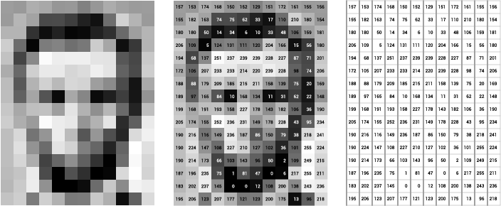
What is a pixel?
The Basic Unit of an Image
Think of a pixel as a numerical representation at location (x,y) in an image.
It is either a single value (in grayscale images representing the black intensity), or a tuple of 3 values representing the Red, Green, and Blue intensities.

Slide 12
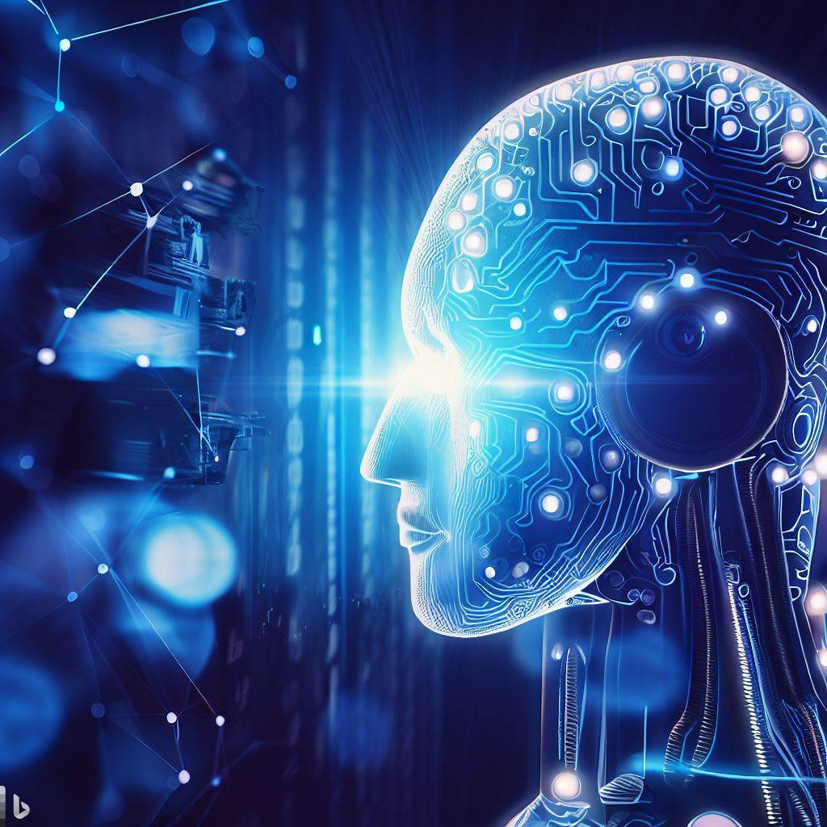
Transition to AI in Machine Vision
The evolution of AI, especially Deep Learning, has revolutionized Machine Vision. AI enhances its accuracy and enables the recognition of complex patterns.
In upcoming sessions, we’ll dive deeper into how CNNs work and how they’re applied in real-world scenarios

Slide 13
Convolutional Neural Networks - A Sneak Peek
Convolutional Neural Networks (CNNs) are a class of deep neural networks, most commonly applied to analyzing visual imagery. They are powerful for automated feature extraction in images, which we'll delve into in later lectures. Here's a visual to give you a taste of what's coming!

Slide 14
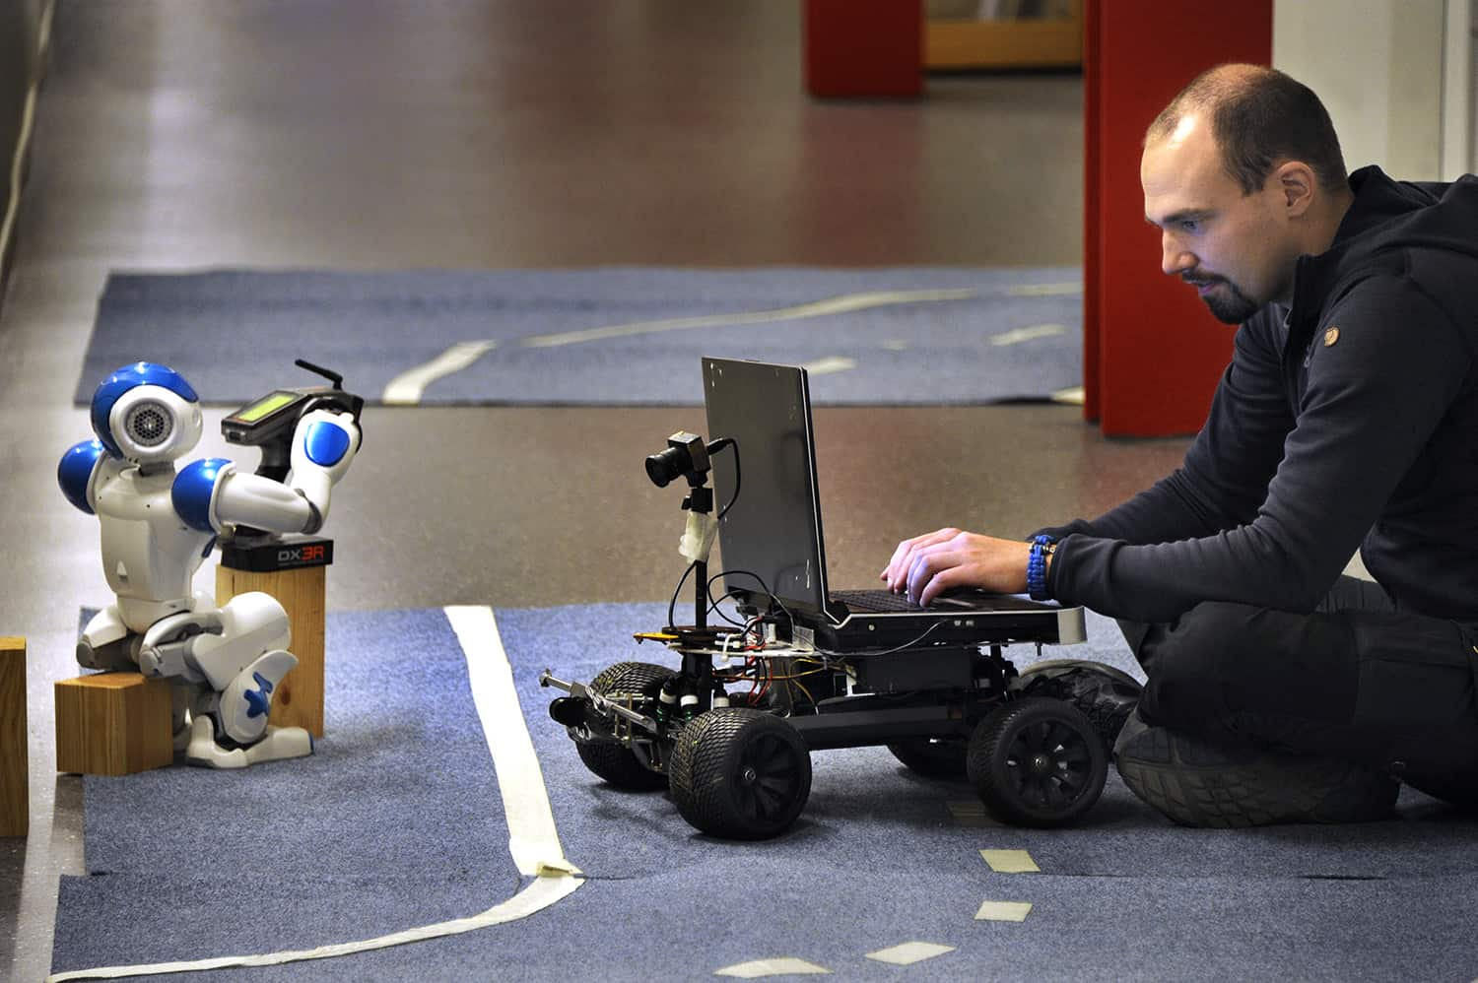
Career Opportunities in Machine Vision
The skills you acquire in this course open doors to numerous career paths. Potential roles include Machine Vision Engineer, Data Scientist, and Research and Development positions. Industries that are actively seeking these skills range from Healthcare to Automotive and Consumer Electronics.

Slide 15

Resources for Further Learning
To deepen your understanding, here are some recommended resources:
https://youtu.be/ArPaAX_PhIs?si=iB53B6NqweLtwVUD
Let’s be honest…. ChatGpt is an excellent learning resource too!
We'll also be using Python, OpenCV, and PyTorch extensively, so familiarizing yourself with these tools will be beneficial.

Slide 16
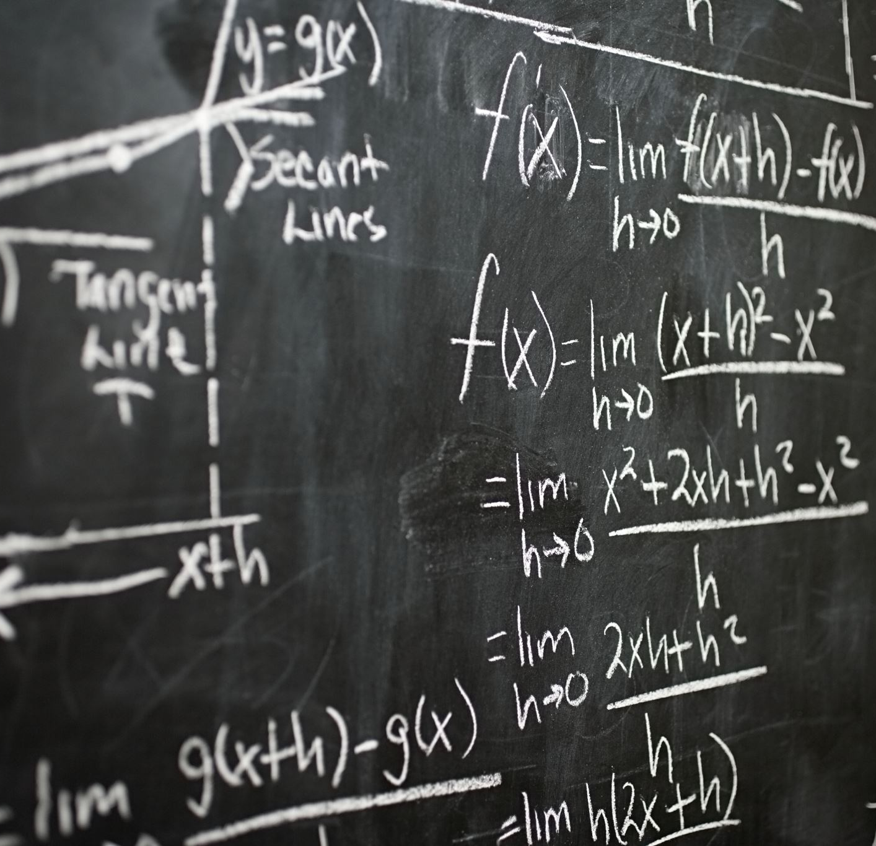
Summary of Today’s Lecture
• The basics of Machine Vision.
• Its history and key technologies.
• Real-world applications, from everyday
uses to advanced fields.
Remember, the world of Machine Vision is as expansive as it is exciting, and you're just getting started!
Images are generated by Microsoft Copilot AI tool

Slide 17
Next Week Preview
Next week, we'll dive into the Fundamentals of Image Processing. We'll explore how images are captured, processed

